Slide 1
Variables

Slide 2
Visual Basic Statement
An instruction can contain
  Keywords: Reserved Words For Visual Basic Use
  Operators: Symbols used to perform operations
  Variables: Symbolic names given to values stores in memory
  Literal Values: Simple values eg. 5 or “Hello”
  Constants: Same as variables except their assigned values cannot change
  Expressions: Combination of terms and/or keyword that yield a value

Slide 3
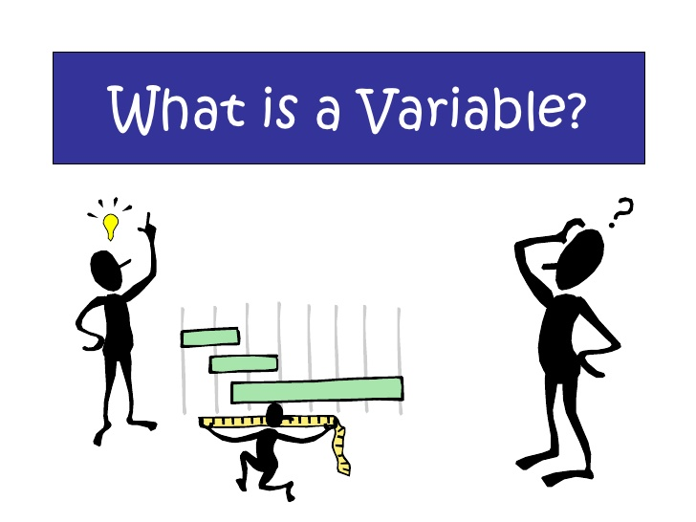
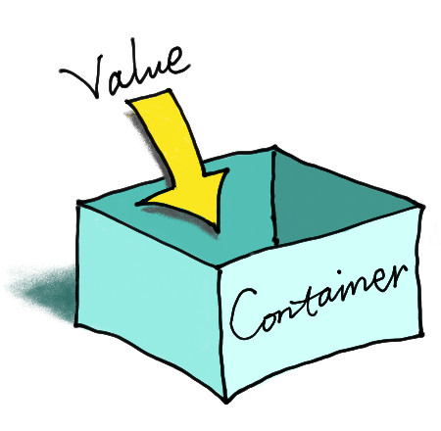

Slide 4
Variable Naming Convention
When declaring variables, you should follow a few naming conventions. A variable’s name:
  Must begin with a letter.
  Can’t contain embedded periods.
  Must not exceed 255 characters
  Must be unique within its scope
  Variable names in VB.NET are case-insensitive.

Slide 5
Types of Variables
Numeric String Char Boolean Date Object
Byte Short Integer Long Single Double Decimal

Slide 6
Numeric Data types
Data type | Memory | Description
Byte | 1 byte | Integer values in the range 0 to 255
Short (Int16) | 2 byte | Integer values in the range -32,768 to 32,767
Integer (Int32) | 4 bytes | Integer values in the range -2,147,483,648 to 2,147,483,647
Long (Int64) | 8 bytes | Very large integer values Integers approximately -9E18 to 9E18
Single | 4 bytes | Single-precision floating-point numbers
Double | 8 bytes | Floating point values approximately - 17.9E308 to-4.9E-324 for negative values. For positive values 4.9E-324 to 1.7E308
Decimal | 12 bytes | Floating point values with 29 digits, with anywhere from 0 to 28 of the digits to the right of the decimal point. Range approximately +/- 7.9E28

Slide 7
Other Data types
Data type | Memory | Description
Char | 2 bytes | Integers 0 to 65535
String | Twice the number of characters plus 10 | Any text from 0 to approximately 2 billion characters in length.
Boolean | 4 bytes | True or False
Date | 8 bytes | Date/Time values between January 1, 0001 and December 31, 9999
Object | 4 bytes | Object references or any other data type

Slide 8
The Byte Data Type
The Byte data type holds an integer in the range 0 to 255.
In addition to the Byte data type, VB.NET provides a Signed Byte data type (sByte) , which can represent signed values in the range from -128 to 127.
Example:
Dim a, b, c As byte
a = 233
b = 50
c=a+b ‘overflow-expression
Console.WriteLine(c)

Slide 9
Data Type Identifiers
We can omit the As clause of the Dim statement, yet create typed variables, with the variable declaration characters, or data type identifiers.
Symbol Data Type Example
$ String Dim name$
% Integer (Int32) Dim num%
& Long (Int64) Dim n&
! Single Dim val!
# Double Dim x#
@ Decimal Dim dec@

Slide 10
Converting Data Types
In some situations, we need to convert variables from one type into anther.
Some of these data type conversion functions are:
CBool Cbyte CChar
Cdate CDbl CDec
CInt CLng CObj
CShort CSng CStr
Example:
  Dim a As Integer, b As Single
  a = 10
  b = CSng(a)

Slide 11
Explicit Option
VB.NET does not require that you declare variables, but the default behavior is to throw an exception if you attempt to use a variable that has not been previously declared.
If an undeclared variable’s name appears in your code, the editor will underline the variable’s name with a wiggly red line, indicating that it caught an error.
To change the default behavior, we must insert the following statement at the beginning of the file, above the Imports statements:
Option Explicit Off

Slide 12
Explicit Option
The default value of the Option Explicit is On. This is also the recommended value.
When the Explicit Option is set Off, VB cannot make any assumption as to the variable’s type, so it uses a generic type of variable that can hold any type of information.
These variables are called Object variables OR Variants.

Slide 13
Strict Option
The Strict option tells the compiler whether the variables should be strictly typed.
The default value of the Strict Option is Off. This means the compiler allows the mix and match variable types.
**Variants are permitted only when Strict Option is off
If you turn the Strict Option On by inserting the following statement at the beginning of the file, you will not be able to mix and match variable types
Option Strict On

Slide 14
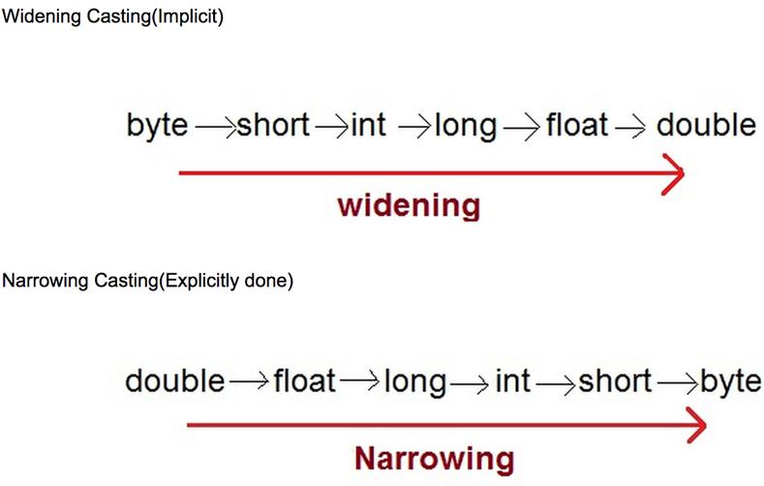
Widening & Narrowing
When the Strict Option is On

Slide 15
Validating User Input
The following are few of the functions used to validate user input, as well as data stored in files, before we process them:
Functions | Description
IsNumeric(Expression as Object) | Returns True if passed a numeric value
IsArray(varName as Object) | Returns True if passed an array
IsDate(Expression as Object) | Returns True if passed a date
IsDBNull(Expression as Object) | Returns True if passed a value is the database NULL value
IsReference(Expression as Object) | Returns True if Expression represents a reference type, such as a class instance, a String type, or an array of any type; otherwise, it returns False.

Slide 16
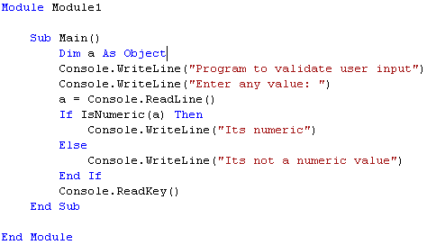
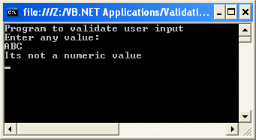
Example: IsNumeric()

Slide 17
IsDBNull: Example
Dim testVar As Object
Dim nullCheck As Boolean
nullCheck = IsDBNull(testVar)
testVar = ""
nullCheck= IsDBNull(testVar)
testVar=System.DBNull.Value
nullCheck = IsDBNull(testVar)
' The first two calls to IsDBNull return False; the third returns True.

Slide 18
IsReference: Example
Dim testArray(3) As Boolean
Dim testString As String = "Test string“
Dim testObject As Object = New Object()
Dim testNumber As Integer = 12
testArray(0) = IsReference(testArray)
testArray(1) = IsReference(testString)
testArray(2) = IsReference(testObject)
testArray(3) = IsReference(testNumber)
‘The first three calls to IsReference return True. The last call returns False, because Integer is a value type, not a reference type.

Slide 19
Formatting Numbers: ToString()
This method can be used to convert a value to the equivalent string
It can also format a value at the same time during conversion, if desired.
Example:
  9959.95.ToString() REM returns “9959.95”
  9959.95.ToString(“Rs ###,###.###”)
  REM returns “Rs 9,959.95”
All # symbol will be replaced by numeric digits, starting from the right.
There are many standard numeric and date format strings.

Slide 20
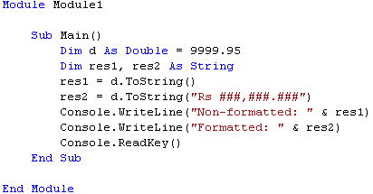
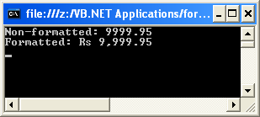
Example

Slide 21
Examining Variables
There are two methods that can be used to examine the type of a variable: GetType() and GetTypeCode().
  The GetType() method returns a string with the variable’s type
  The GetTypeCode() method returns a value that identifies the variable’s type.

Slide 22
Variables Type & Type Code
GetType() | GetCode() | Description
Boolean | 3 | Boolean Value
Byte | 6 | Byte Value
Char |  | Character
DateTime | 16 | Date/time value
Decimal | 15 | Decimal
Double | 14 | Double-precision floating point number
Int16 | 7 | 2-byte Integer (Short)
Int32 | 9 | 4-byte Integer (Integer)
Int64 | 11 | 8-byte Integer (Long)
Object

Slide 23
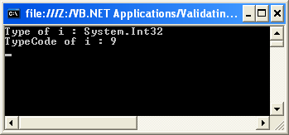
Example
Dim i As Integer
Console.WriteLine("Type of i : " & i.GetType().ToString())
Console.WriteLine("TypeCode of i : " & i.GetTypeCode())

Slide 24
User-defined Data type
A structure for storing multiple values (of the same or different type) is called a record.
To define a record in VB.NET, use the Structure statement. For example:
Structure student
  Dim varName As String
  Dim varRoll As Integer
  Dim varClass As Integer
  End Structure
  To declare variables of this new type, we can write:
  Dim s1 As student, s2 As student
  To assign values to one of these variables, we can write:
  s1.varRoll=1

Slide 25
Scope of Variables
The scope (or visibility) of a variable is the section of the application that can see and manipulate the variable.
If a variable is declared within a procedure, only the code in the specific procedure has access to that variable. In such a case, it is called local.

Slide 26
Scope of Variables
In case of a block-level scope, variables introduced within a block of code (e.g. a loop) are local to the block but invisible outside the block.
In case of a procedure-level scope, a variable is visible within the procedure and invisible outside the procedure.
In case of module-level scope, variables declared outside any procedure in a module are visible from within all procedures in the same module, but they are invisible outside the module.
Finally, in some situation the entire application must access a certain variable. In this case, the variable must be declared as Public. Public variables have a global scope.

Slide 27
Lifetime of a Variable
Variables have a lifetime, which is the period for which they retain their value.
  Variables declared as Public exist for the lifetime of the application.
  Local variables declared within procedures with the Dim or Private statement, live as long as the procedure.
  However, one can force a local variable to preserve its value between procedure calls with the Static keyword.

Slide 28
Access specifiers
Syntax: Access variable_name As Datatype
Dim: Declares a variable that can be used within a single procedure or within just a part of the procedure
Private: Declares variable in a class/module and accessible to procedures within them
Public: Declares variables which are accessible to all classes and modules within a project
Static: Declares a variable which can retain its value from one execution of a procedure to another

Slide 29
Thank you

